Slide 1


Holidays

Slide 2


Slide 3
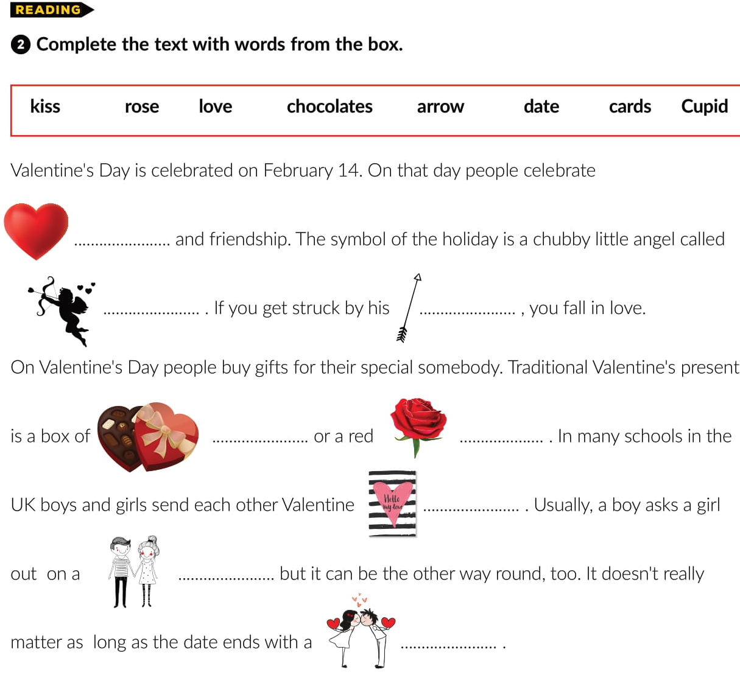
love
Cupid
arrow
chocolates
rose
card
date
kiss

Slide 4

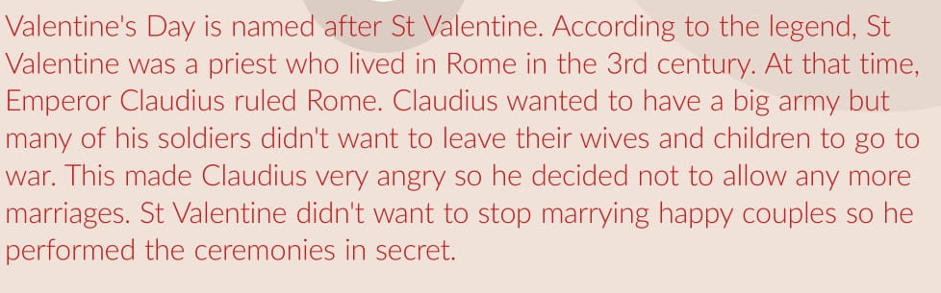
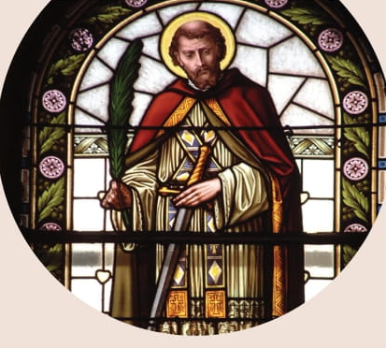
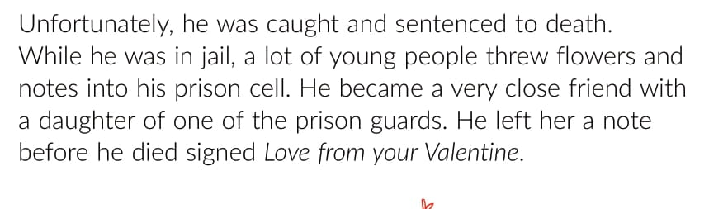

Slide 5



Slide 6
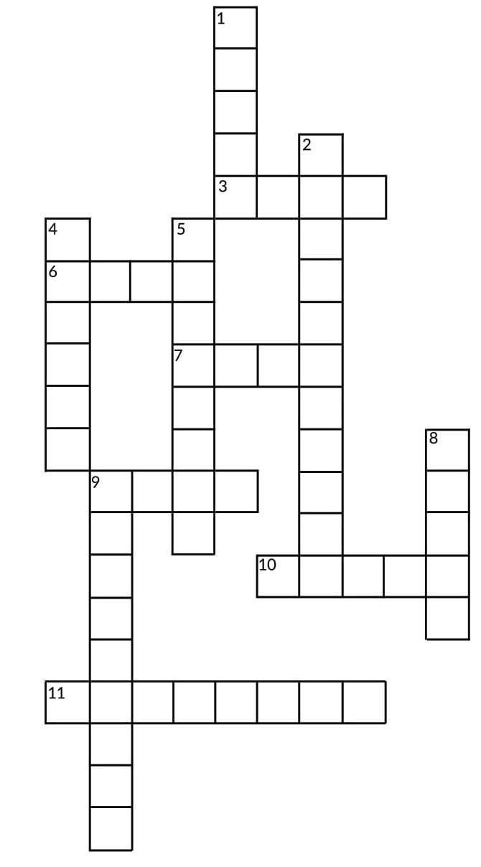
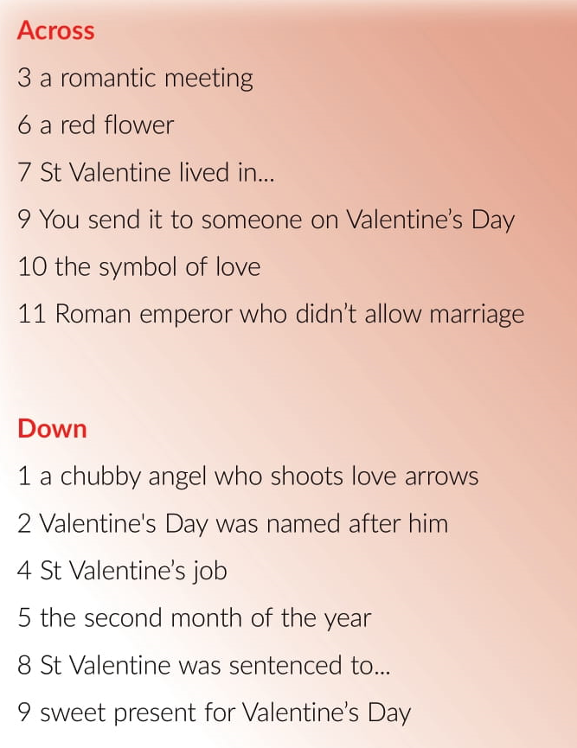


CUPID
ST
VAL
E
N
TIN
E
A
E
P R I E S T
F
B R U A R Y
O S E
O M
D E A T H
C
HOCOLATE
A D
H A R
C A U D I U S

Slide 7
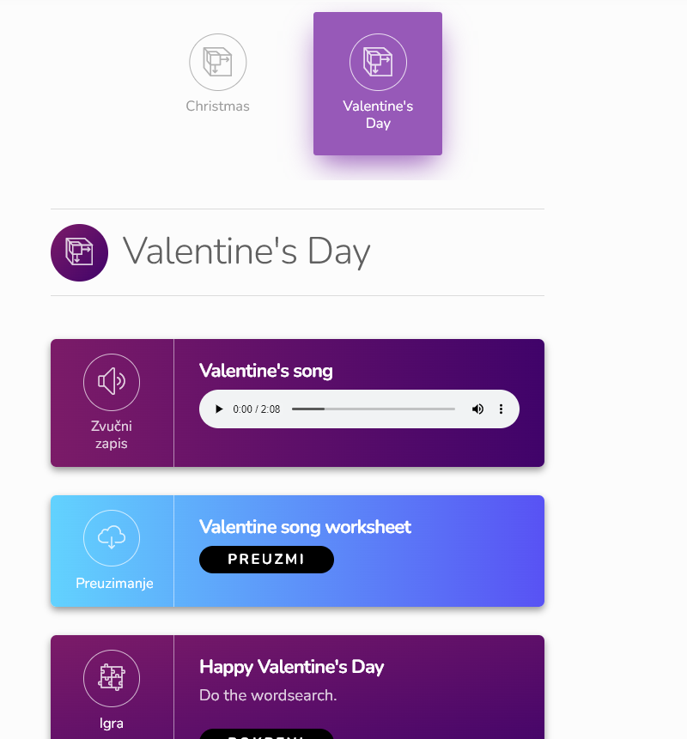
Extra pages -Holidays | Way to go 3 (e-sfera.hr)

